Slide 2
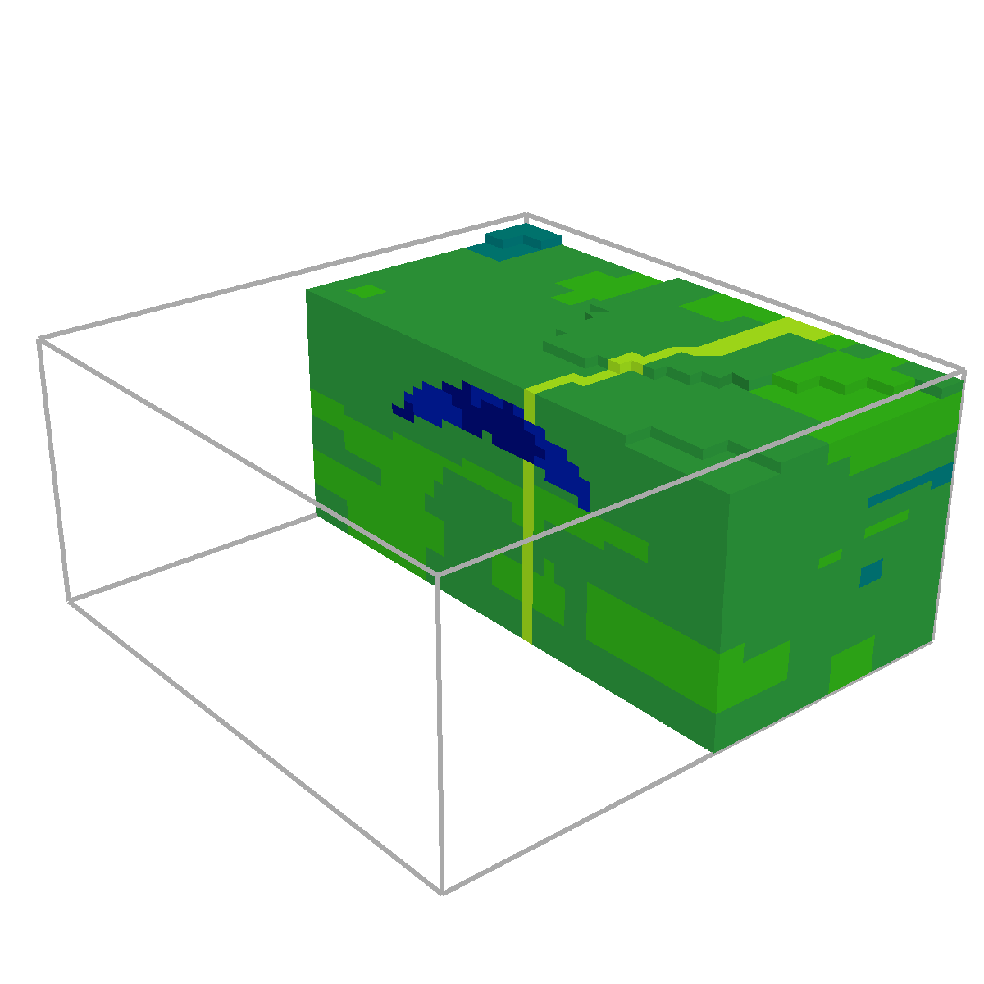
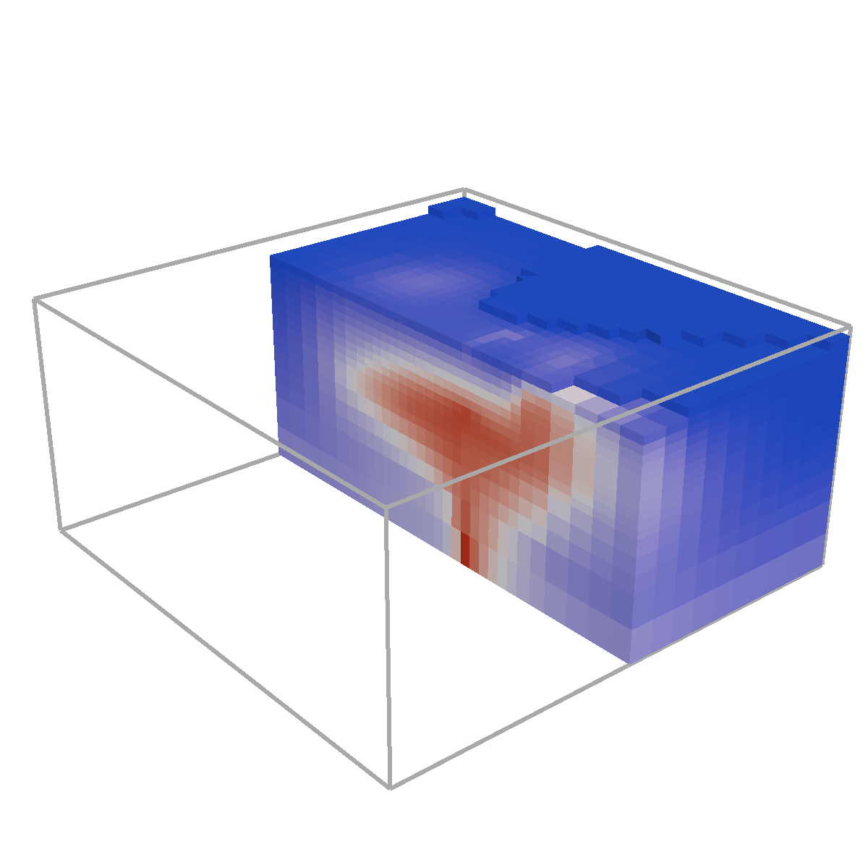

Slide 3
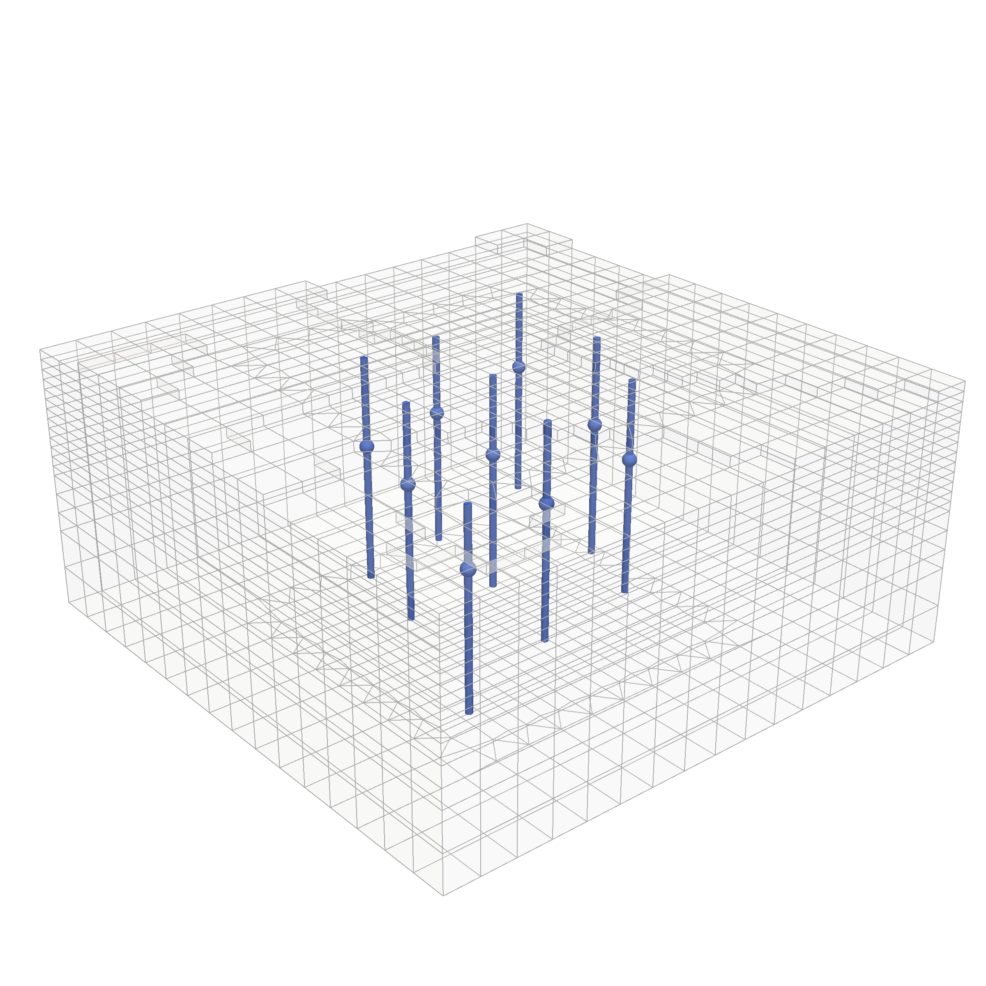

Slide 6
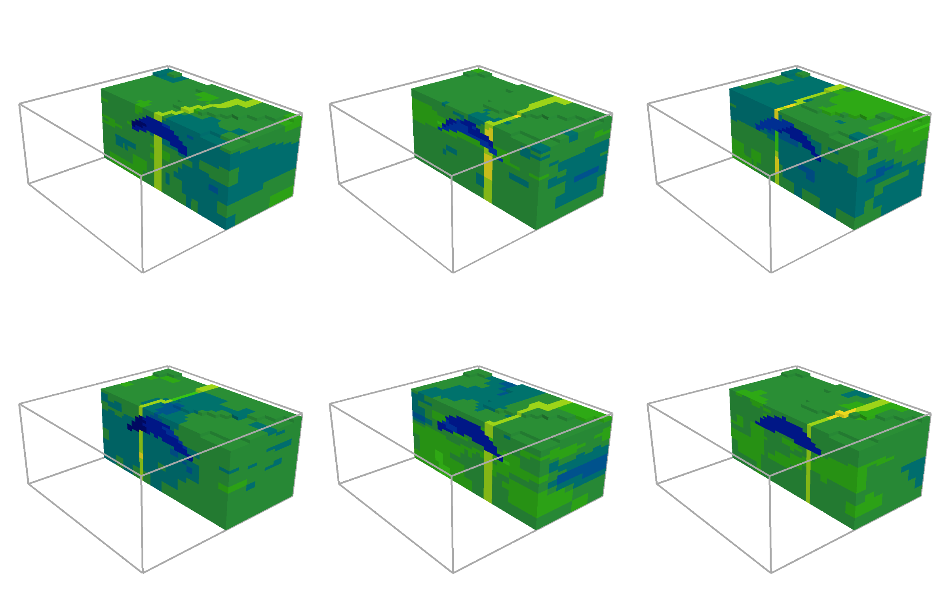

Slide 7
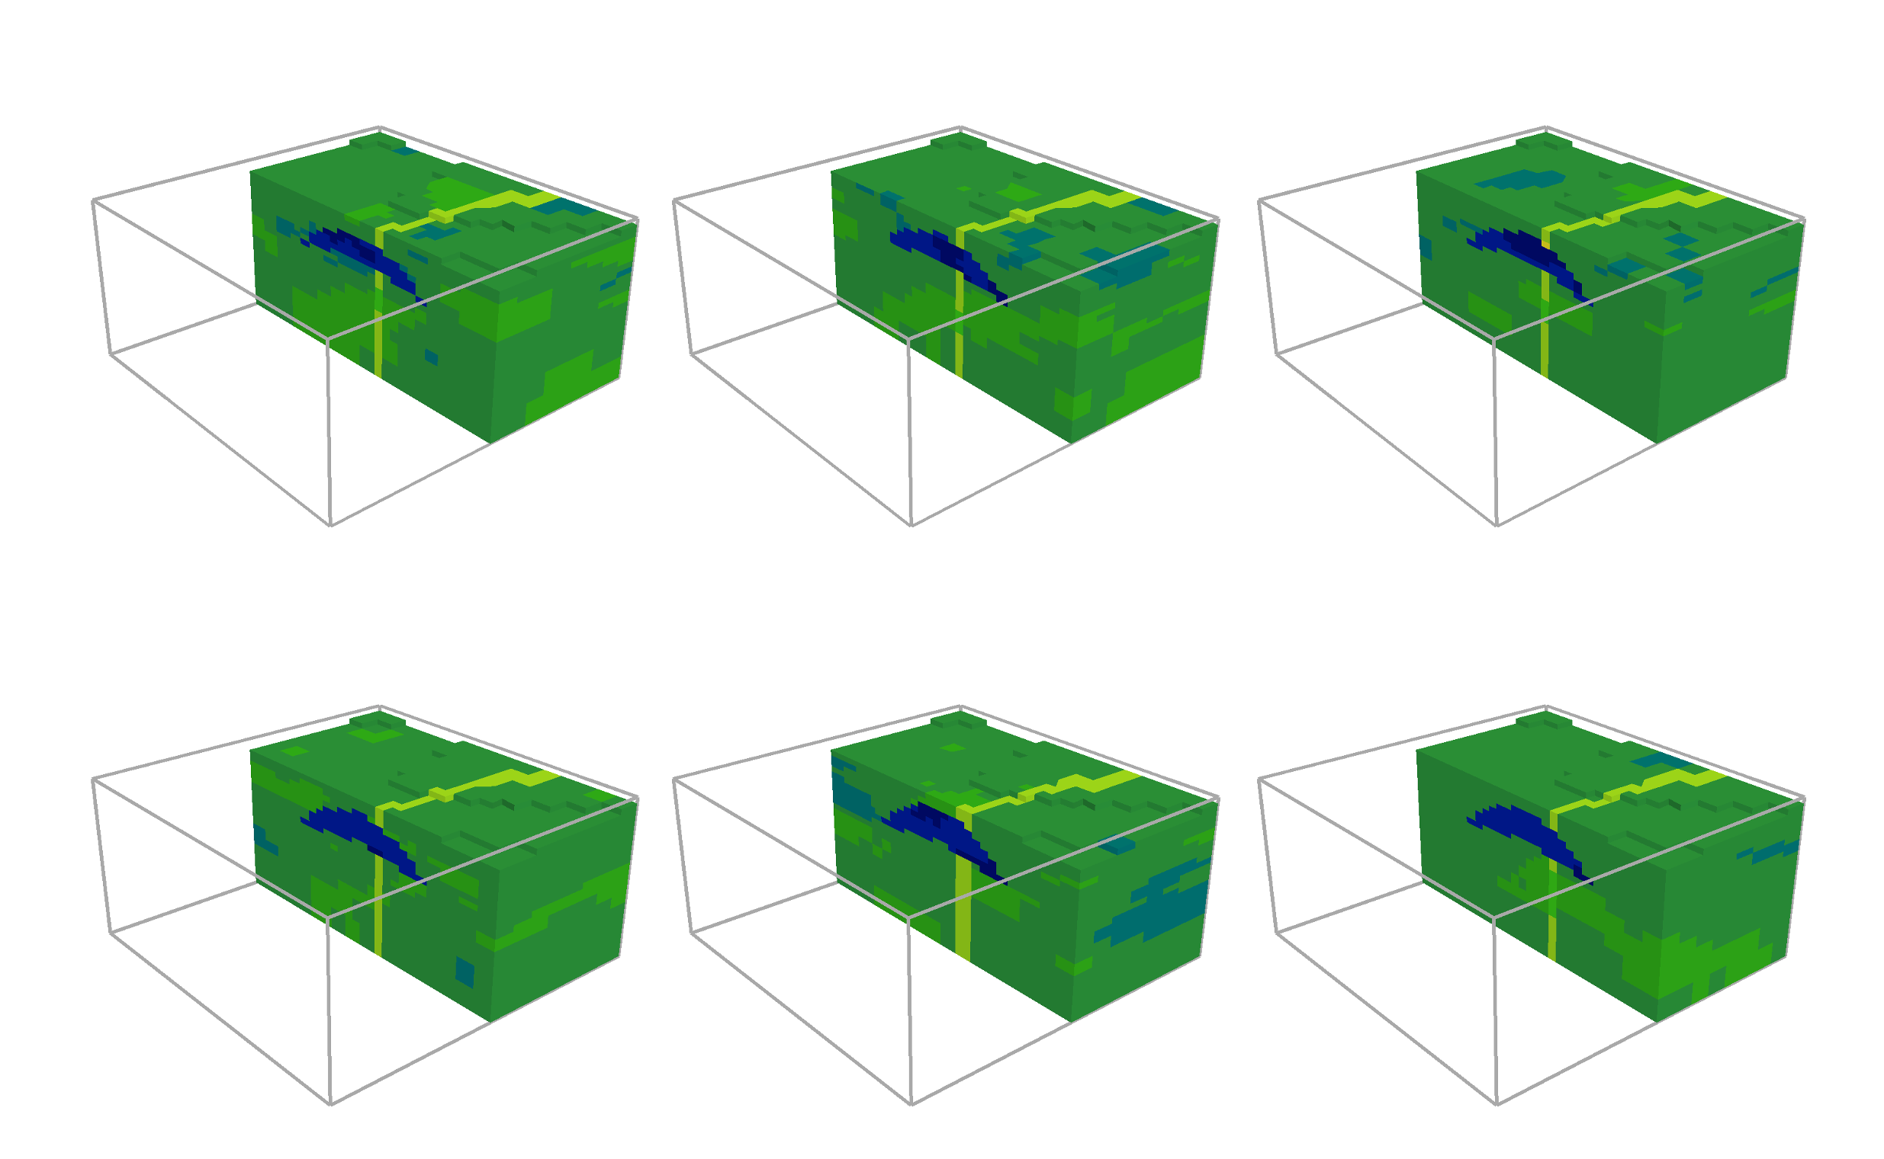

Slide 8
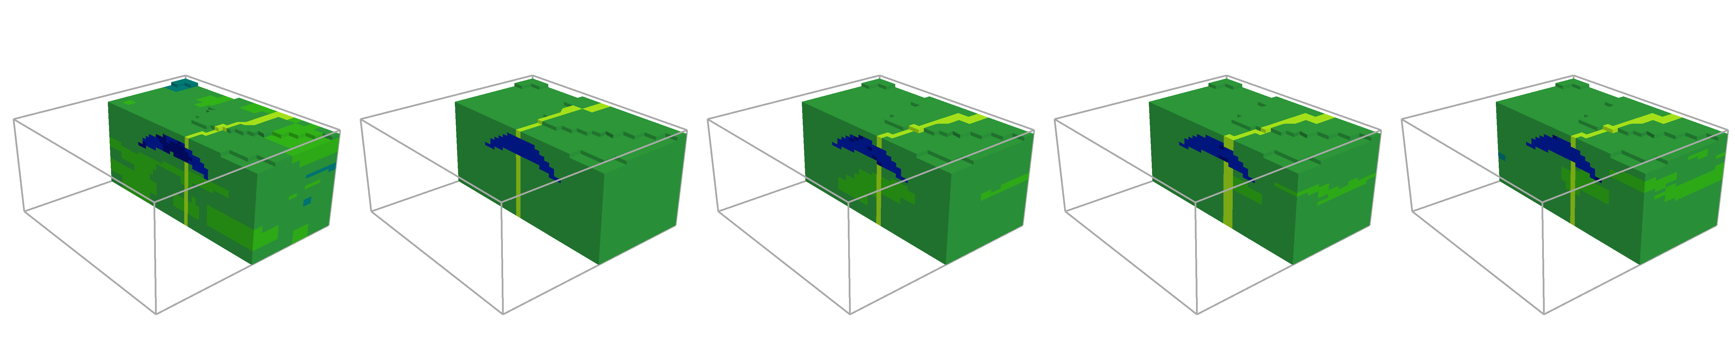
Truth
Prior
EKI
EKI (Localisation)
EKI (Inflation)

Slide 9
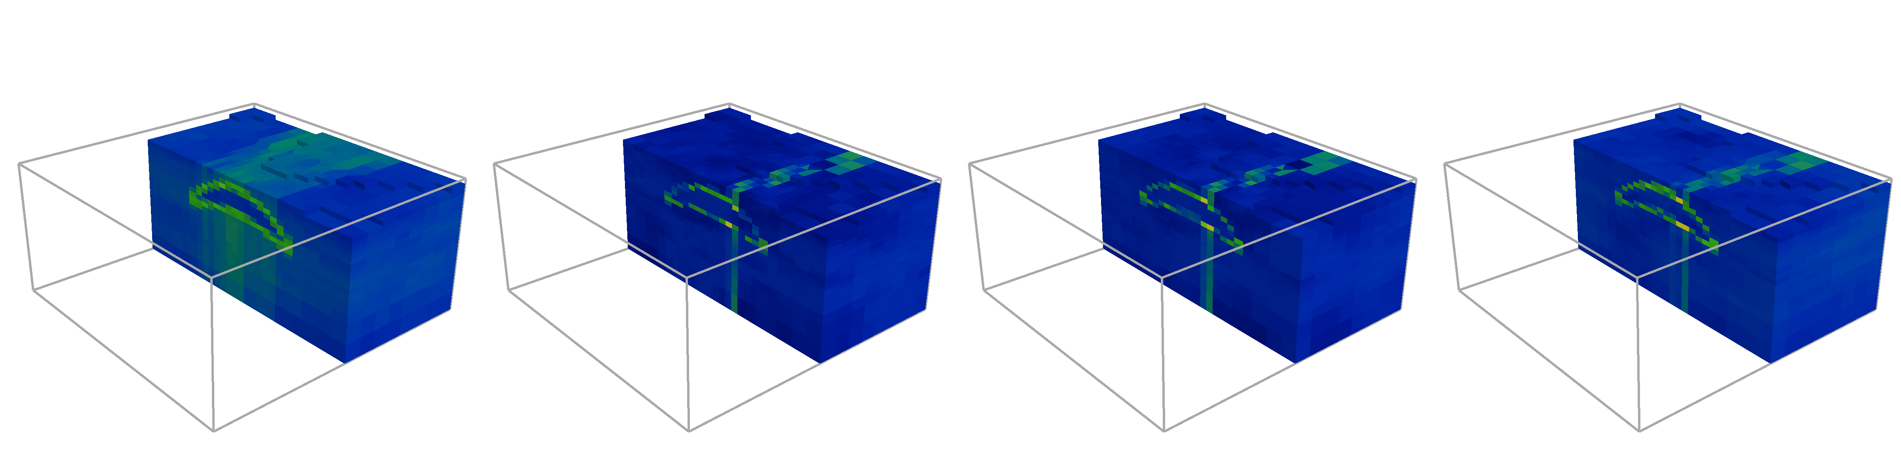
Prior
EKI
EKI (Localisation)
EKI (Inflation)

Slide 10
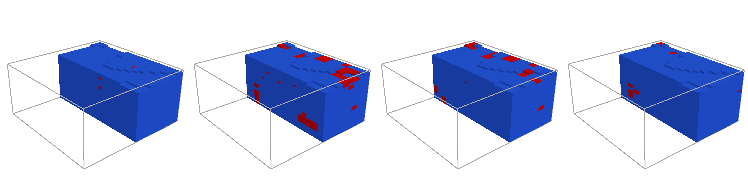
Prior
EKI
EKI (Localisation)
EKI (Inflation)

